Slide 1
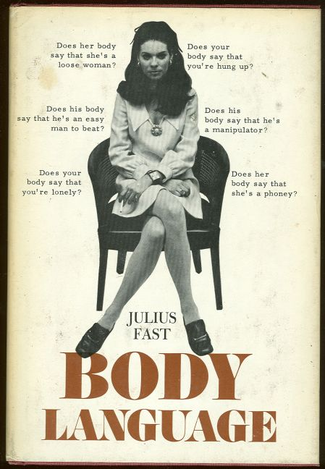
Nonverbal Communication

Slide 2
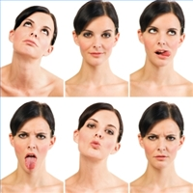
The “secret language”?
Do we say everything we need to say with words?
How have you communicated without using any words at all?
What differences (if any) in nonverbal communication have you noticed when you have interacted with people from different cultures?

Slide 3
Today’s lecture
The functions of nonverbal communication
The dimensions of nonverbal communication:
Kinesics
Vocalics/paralanguage
Physical appearance
Haptics
Proxemics
Chronemics
Differences in nonverbal communication across cultures
Two theories that involve nonverbal communication:
Nonverbal Expectancy Violations Theory
Communication Accommodation Theory

Slide 4
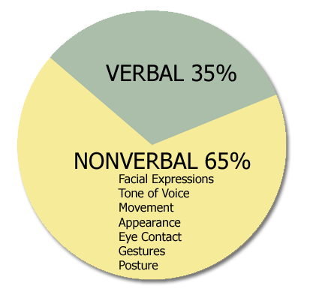
Functions of Nonverbal Communication
Repeat, substitute, and complement verbal messages
Contradict verbal cues
Express attitudes and emotions
Regulate the flow of conversations
http://mashable.com/2014/01/23/conference-call-in-real-life/

Slide 5



Dimensions of Nonverbal Communication: Kinesics
Movements of head, face, eyes, limbs, trunk
Eye contact and mutual gaze are the best indicators of mutual attraction.
Produces a reliable increase in compliance

Slide 6

Vocalics/ paralanguage
Also called paralinguistics
Not WHAT is said, but HOW it is said
Rate, pitch and tone all affect the meanings we attribute to an act of communication.
A relatively fast rate and short silent pauses results in increased compliance.
Like this?
“Vocal pleasantness” is associated with fluency and pitch variety.

Slide 7
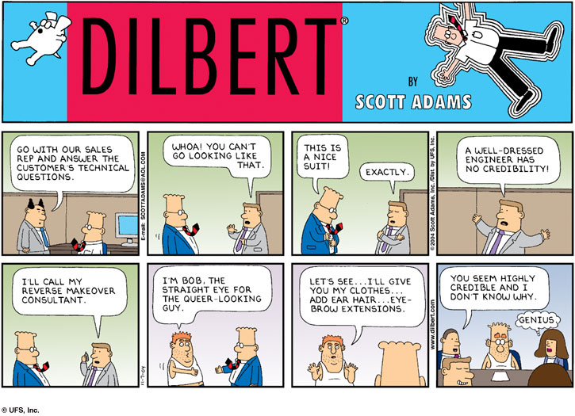
Physical appearance
People who dress similarly to their targets are more persuasive than those dressed differently (Exc: expectations)
Clothing and other artifacts signal group membership
High status clothing, attractive facial features, and conventional appearance are associated with greater persuasiveness.
Uniforms produce an automatic cognitive response that makes us inclined to comply.

Slide 8
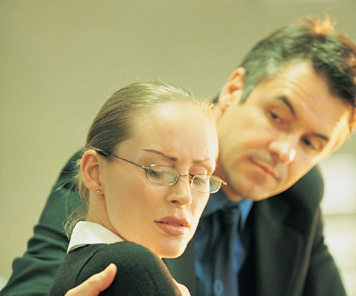
Haptics
Haptics: The use of touch.
Nonreciprocal touch is a sign of dominance and/or power.
Appropriate touch is a sign of liking and affiliation, which can lead to greater persuasion.
Where are you “allowed” to touch people who are acquaintances/colleagues?

Slide 9
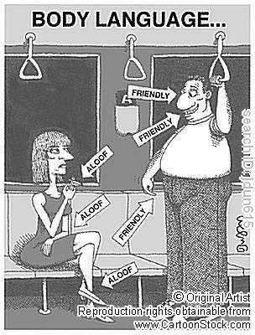
Proxemics
Proxemics: The use of territory and/or space.
Higher status people are given more space.
Closer personal space and touch tend to be associated with increased persuasiveness.
People with high reward power can violate personal space and produce favorable effects on compliance.
The “close talker”

Slide 10
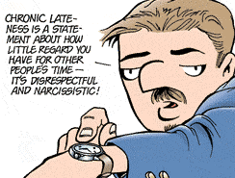
Chronemics
Chronemics: The use of time to communicate.
What does it mean to be “on time”? How late can you be and still be “one time”?
With friends
With co-workers
With a boss
For a job interview

Slide 11

Cultural differences: Proxemics
Use of personal space/distance:
East Asians prefer more space.
South Americans (and southern Europeans) prefer less space.
Americans prefer a moderate amount of space.
Territory:
Low power distance cultures (like the U.S. and Europe) are less likely to cede space to people with power.
Greater materialism = more concern about defending territory

Slide 12

Cultural differences: Kinesics
When yes means no (and no means yes): The strange case of Bulgaria
Use of gestures in Mediterranean cultures
Standing in line: straight lines vs. a line within a crowd (“Ultima?”)

Slide 13

Cultural differences: Chronemics
Cultural/subcultural norms for the use of time vary widely.
Monochronemic cultures (like the U.S.) want people to be on time. Violations result in decreased persuasion.

Slide 14

Cultural differences: Sensory involvement
People in some cultures prefer high contact between people. They want to touch, smell, kiss, and make eye contact with the people with whom they are communicating.
High: South Americans, Southern and Eastern Europeans, Arabs
Low: East Asians
Moderate: Northern Europeans, North Americans
Kissing, shaking hands, or bowing as greeting rituals.

Slide 15
“So many cultural differences!”
Being aware of cultural differences in nonverbal communication will help you avoid appearing rude, which will help you when you are trying to persuade people in intercultural contexts.
Communicating Across Cultures: Joe Lurie
http://www.youtube.com/watch?v=oTfsansAKqA

Slide 16
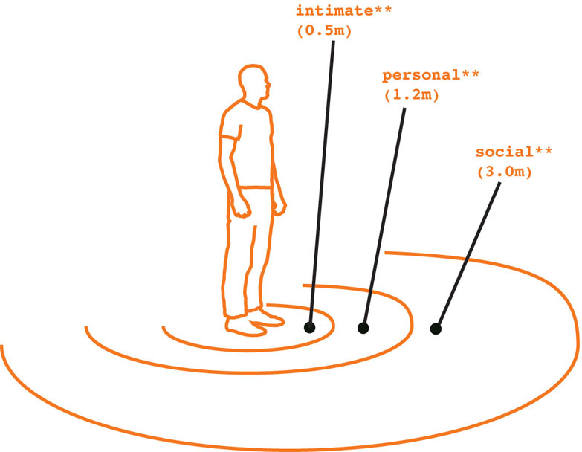
Nonverbal Expectancy Violations Theory
We have expectations for people’s nonverbal communication.
When these expectations are violated:
Receivers experience both arousal and distraction
Receivers’ attention shifts to the person, their relationship, and meaning of the violation
Less attention is paid to the message itself

Slide 17


Expectations
Our expectations for nonverbal communication are based on:
Context: The social norms that are part of our normal, everyday life. Also includes our norms for the environment in which we are communicating.
Relationship: How much we like the person and how familiar we are with them. The social power of each individual is also part of our feelings about the relationship.
Communicator: The other person’s age, sex, personality, and appearance.

Slide 18
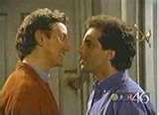
Interpretations/Evaluations of Violations
Valence of the violation (positive or negative) is determined by:
Communicator reward power
Whether or not the behavior is more or less favorable than the expectation
The magnitude of the violation
Positive violations produce more favorable outcomes than behavior that matches expectations.
Negative violations produce more unfavorable outcomes than behavior that matches expectations.

Slide 19

Communication Accommodation Theory
Expansion of Speech Accommodation theory to nonverbal communication.
Interpersonal synchronization: convergent rhythmic movements on both the verbal and nonverbal levels.
Demonstrates nonverbal communication’s effect on relationship development and maintenance

Slide 20
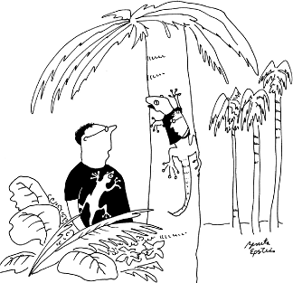
Liking, rapport, and attention are associated with synchrony (convergence), while misalignment (divergence) is associated with disliking and indifference.
Imitation really is the sincerest form of flattery.
When we interact with people from other cultures, synchrony can be thrown off through the violation of distance norms and differences in verbal rhythms.

